Slide 1
IBM UNIVERSITY ENGAGEMENT | PROJECT SUBMISSION
IBM AICTE Internship
TikZ Diagram Generator
Powered by IBM Granite & watsonx.ai
An AI-powered, research-assisted, multi-agent platform transforming natural-language descriptions into publication-quality LaTeX/TikZ diagrams.
Domain: Computer Science / AI / Technical Diagramming
Presenter: Susnata Maiti
github.com/Susnata-Maiti/TikZ-Diagram-Generator

Slide 2

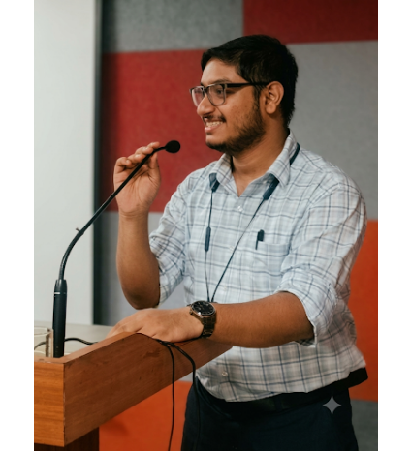
IBM UNIVERSITY ENGAGEMENT | PROJECT SUBMISSION
Student & Project Information
PROJECT OVERVIEW
TikZ Diagram Generator
Domain: Computer Science / AI / Technical Diagramming
STUDENT DETAILS
Name: Susnata Maiti
Email: maitisusnata135531@gmail.com
Mobile: 8240506045
github.com/Susnata-Maiti/TikZ-Diagram-Generator

Slide 3
IBM UNIVERSITY ENGAGEMENT | TIKZ DIAGRAM GENERATOR
Problem Statement
The Challenge
The Objective
•
Manual Complexity: Drafting UML, ERDs, and circuits in TikZ is tedious.
•
Multimodal Input: Accept plain English, specs, or hand-drawn sketches.
•
Steep Learning Curve: Existing tools demand expert LaTeX syntax fluency.
•
Standards Compliance: Support 17+ categories including UML, ERD, and circuits.
•
No Automation: Plain English rarely compiles into valid diagrams.
•
Validated Output: Auto-repair and compile directly to PDF and PNG.
•
Strict Notations: 17+ diagram categories require distinct symbol standards.
•
Agentic Intelligence: Use IBM Granite for reasoning, repair, and RAG.
Core Gap: No unified platform converts natural language into standards-compliant TikZ across 17+ diagram types.

Slide 4
IBM UNIVERSITY ENGAGEMENT | TIKZ DIAGRAM GENERATOR
Proposed Solution
Multi-agent AI platform powered by IBM watsonx.ai and Granite converting plain English into compiled PDF & PNG diagrams.
Intent Agent
Research Agent
Convention Engine
Layout Engine
Validate & Repair
NL to Structured IR (Granite)
Web Search + Granite RAG
Deterministic Collision Solver
6-Stage Check + Auto-Fix
17+ Profiles & TikZ Styles
System Outputs
Key Capabilities
•
•
Multimodal & Broad: 17+ categories & vision sketch-to-diagram
Compiled Graphics: Publication PDF & 220 DPI PNG preview
•
Source & Schema: Raw TikZ/LaTeX code & structured IR JSON
•
Resilient Pipeline: Up to 3 autonomous Granite repair cycles
•
Audit Artifacts: 6-stage validation report & RAG citations
•
Interactive State: Full undo/redo history & RAG enrichment

Slide 5
IBM UNIVERSITY ENGAGEMENT | TIKZ DIAGRAM GENERATOR
Technology Used
IBM watsonx.ai
IBM Granite Models
FastAPI + Next.js
Hosts Granite and Llama models with enterprise governance and retry fallback.
Uses granite-4-h-small for IR/repair and llama-4-maverick for sketch vision.
Python 3.11 async REST backend paired with React live preview and sketch upload.
pdflatex / TeX Live
Pydantic IR Schema
DuckDuckGo / SerpAPI
Local compilation with texlive.net fallback producing PDF and 220 DPI PNGs.
Central DiagramIR single source of truth for nodes, edges, groups, and geometry.
Live web RAG pipeline enriching prompts with real technical specifications.

Slide 6
IBM UNIVERSITY ENGAGEMENT | TIKZ DIAGRAM GENERATOR
Backend Components Used
1. GraniteClient
2. IntentAgent
3. ReasoningAgent
Wraps ModelInference for chat, JSON, and vision with 3-retry back-off.
Parses natural language and refinement commands into DiagramIR JSON.
Audits IR for UML members, circuit topology, and sequence lifelines.
4. ConventionRegistry
5. LayoutEngine
6. TikZGenerator
Defines shapes, TikZ libraries, styles, and routing for 17+ diagram types.
Runs topological sort, bounding boxes, and 10-step collision resolution.
Emits standalone LaTeX with UML splits, pgfonlayer groups, and anchors.
7. ValidationPipeline
8. ResearchManager
9. HistoryService
Executes 6 checks from semantics to compilation plus 3 Granite repairs.
Combines DuckDuckGo/SerpAPI search with Granite technical synthesis.
Maintains session undo/redo stacks with optional Redis persistence.

Slide 7
IBM UNIVERSITY ENGAGEMENT | TIKZ DIAGRAM GENERATOR
Multi-Agent Workflow
STAGE 1: AGENTIC INPUT & REASONING PIPELINE
Prompt / Sketch
ResearchAgent
IntentAgent
ReasoningAgent
Conventions
User Input
RAG Context
Builds IR JSON
Logic Audit
17+ Rulesets
STAGE 2: DETERMINISTIC LAYOUT, VALIDATION & COMPILATION
LayoutEngine
TikZGenerator
Validation
LaTeXCompiler
REST Response
Exact Geometry
LaTeX Code
6-Stage + Repair
pdflatex / Cloud
PDF • PNG • TikZ
Central DiagramIR (Pydantic): id • category • nodes • edges • groups • geometry • validation • research_sources
Granite NEVER outputs coordinates — all geometry is deterministic.

Slide 8
IBM UNIVERSITY ENGAGEMENT | TIKZ DIAGRAM GENERATOR
Supported Diagram Types
UML Diagrams
Flow & Process
17+
Class Diagram • Use Case Diagram • Sequence Diagram • Activity Diagram • State Diagram
Flowchart • Data Flow (DFD) • BPMN • ERD (Chen / Crow's Foot) • Resource Allocation Graph
Diagram Types
Dedicated ConventionProfile per category with strict notation rules.
Engineering & AI
Specialized Notations
Architecture Diagram • Neural Network • ML Pipeline • Electrical Circuit • Digital Logic Circuit
Quantum Circuit • Finite State Machine (FSM) / Decision Tree • General Graph / Network

Slide 9
IBM UNIVERSITY ENGAGEMENT | TIKZ DIAGRAM GENERATOR
Architecture Blueprint
ORCHESTRATION
WATSONX.AI
CLIENT LAYER
API GATEWAY
Core Services
Granite Agents
Frontend (Next.js)
Backend (FastAPI)
• Intent & Reasoning Agents
REST
• DiagramService: End-to-end flow
• pages/index.js
• POST /generate & /refine
• useDiagramState.js
• POST /upload-sketch
• HistoryService: Undo/redo stack
• ResearchAgent (Web RAG)
• lib/api.js & globals.css
• GET /diagram/{id} • /undo
• SketchInterpreter (Vision)
Engines & Registry: LayoutEngine • ConventionRegistry • TikZGenerator • ValidationPipeline • LaTeXCompiler
Central Schema: DiagramIR (Pydantic) — Single source of truth passed across all layers
Infrastructure: Docker Worker | Vercel (Frontend) | texlive.net (Fallback Compiler) | Redis (Session History)

Slide 10

IBM UNIVERSITY ENGAGEMENT | TIKZ DIAGRAM GENERATOR
Role of Agentic AI in the Solution
IBM Granite agents perceive context, reason independently, and collaborate for standards compliance.
Intent Parsing
RAG Enrichment
Logical Review
Self-Repair Loop
Maps free-form text into structured DiagramIR categories, nodes, and edges.
Retrieves live web data and synthesizes real-world component lists.
Validates UML members, circuit topology, and lifelines before layout.
Diagnoses compiler error logs and fixes TikZ across 3 autonomous retries.
Vision-Based Sketch Interpretation (llama-4-maverick)
SketchInterpreter sends hand-drawn sketches to watsonx.ai vision models to extract node shapes, labels, and edge connections directly into a unified DiagramIR schema.

Slide 11
IBM UNIVERSITY ENGAGEMENT | TIKZ DIAGRAM GENERATOR
Token Usage Across Pipeline Stages
Pipeline Stage | Token Consumption | Input / Output Operation
Intent Parsing | ~1,200 – 2,500 tokens | Natural language prompt to structured DiagramIR JSON
Technical Reasoning | ~800 – 1,500 tokens | IR logical validation and topology correction
Research Agent (Optional) | ~2,000 – 4,500 tokens | Live web snippets to synthesized technical architecture
Repair Loop (Per Retry) | ~1,500 – 3,000 tokens | Compiler error log + TikZ to self-repaired TikZ (max 3x)
Vision / Sketch | ~500 – 1,200 tokens | Hand-drawn sketch image to node/edge JSON via watsonx.ai
Standard Run (No Research, 1 Repair): ~5,000 – 9,000 tokens
Full RAG + Max Repairs: ~15,000 tokens (ibm/granite-4-h-small)

Slide 12
IBM UNIVERSITY ENGAGEMENT | TIKZ DIAGRAM GENERATOR
Novelty and Uniqueness
17+ Standards Profiles
Deterministic Geometry
Autonomous Self-Repair
Dedicated ConventionProfile shapes, libraries, and routing per diagram type.
Coordinates are never hallucinated; collision detection prevents overlaps.
pdflatex error logs trigger up to 3 autonomous Granite self-healing loops.
RAG Research Enrichment
Sketch-to-Diagram Vision
IR-Driven Undo / Redo
Live web retrieval grounds diagrams in accurate domain architecture.
Hand-drawn sketches convert into compiled LaTeX via llama-4-maverick.
Refinements mutate DiagramIR directly for guaranteed structural consistency.

Slide 13
IBM UNIVERSITY ENGAGEMENT | TIKZ DIAGRAM GENERATOR
GitHub Repository & Project Stats
https://github.com/Susnata-Maiti/TikZ-Diagram-Generator
Branch: master
Repository Contents
•
backend/: FastAPI endpoints, Granite agents, compiler, validation, tests
Repository Stats
•
54 Committed Files: Full-stack implementation
•
frontend/: Next.js pages, custom React hooks, REST client, styles
•
Languages: Python, JavaScript, Dockerfile
•
worker/: Production Dockerfile for containerized TeX Live deployment
•
Security: .gitignore protects secrets & .venv
•
Config & Docs: .env.example, README.md, vercel.json, pyproject.toml
•
Test Suite: 6 pytest files (offline mock-ready)

Slide 14
IBM UNIVERSITY ENGAGEMENT | TIKZ DIAGRAM GENERATOR
Future Scope
1. CircuiTikZ Integration
2. quantikz / yquant Support
3. Async Queue (Celery + Redis)
Replace built-in IEC library with IEEE-compliant analog and electrical circuit symbols.
Add multi-qubit gates (Toffoli, controlled-U), barrier lines, and quantum measurements.
Run generation in background tasks for concurrent sessions and live progress tracking.
4. Multi-Language Output (Mermaid & PlantUML)
5. Combined Sequence Fragments & BPMN Swimlanes
Emit Mermaid.js and PlantUML directly from the format-agnostic DiagramIR schema.
Extend layered coordinate geometry to support UML alt/opt/loop blocks and swimlanes.

Slide 15
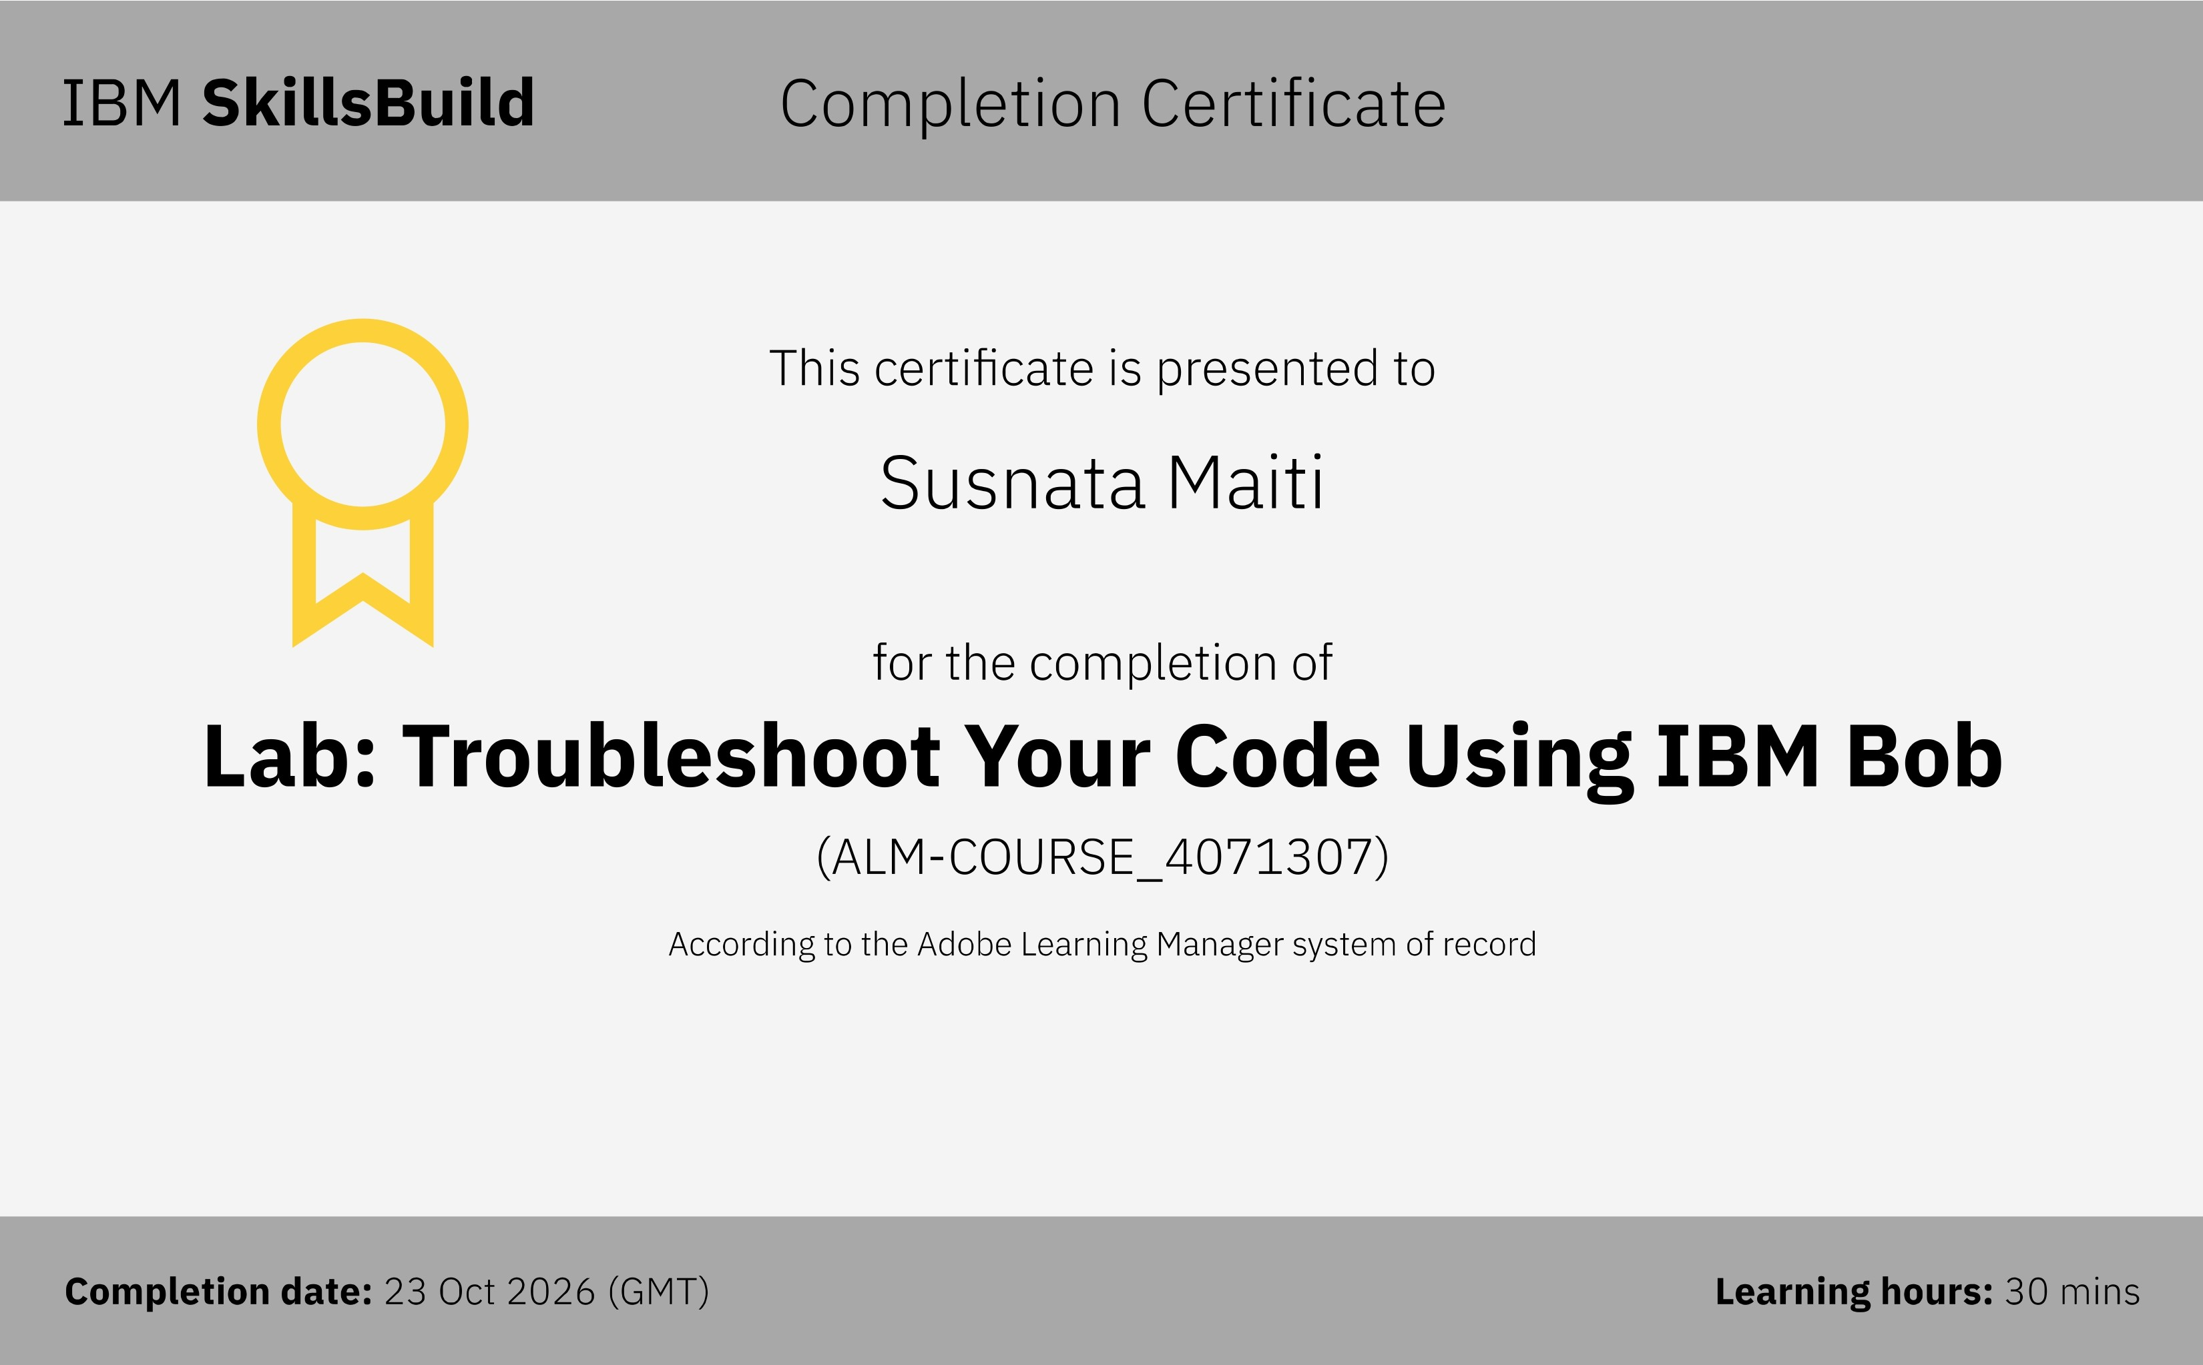
IBM UNIVERSITY ENGAGEMENT | TIKZ DIAGRAM GENERATOR
Certificates Earned — IBM SkillsBuild / IBM Bob
Completed: 23 Oct 2026 | ALM-COURSE_4071307
IBM SkillsBuild | Lab: Troubleshoot Your Code Using IBM Bob | Recipient: Susnata Maiti

Slide 16
IBM UNIVERSITY ENGAGEMENT | AICTE IBM OCTOBER INTERNSHIP
Thank You
TikZ Diagram Generator — Powered by IBM Granite & watsonx.ai
Susnata Maiti

